Slide 1
Hackathon Group 11

Slide 2
Many Reports Have A Surplus Of Non-Pertinent Trials

Slide 3
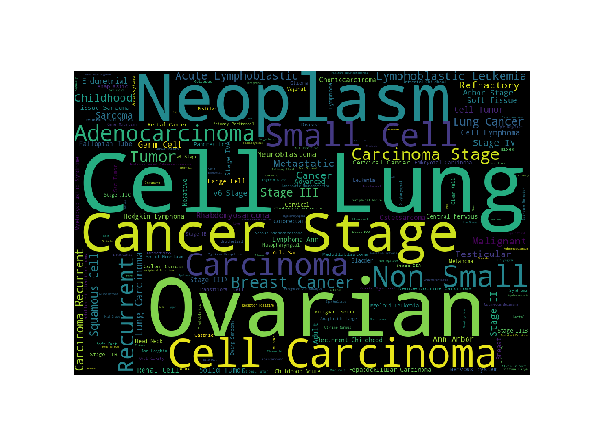

Slide 4
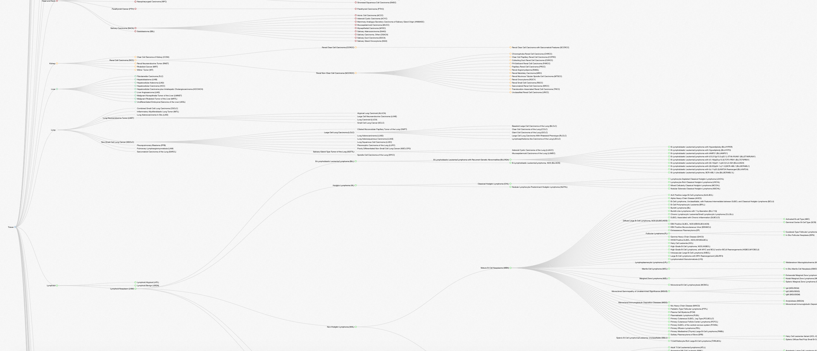
There is No Consistent Disease Ontology

Slide 5
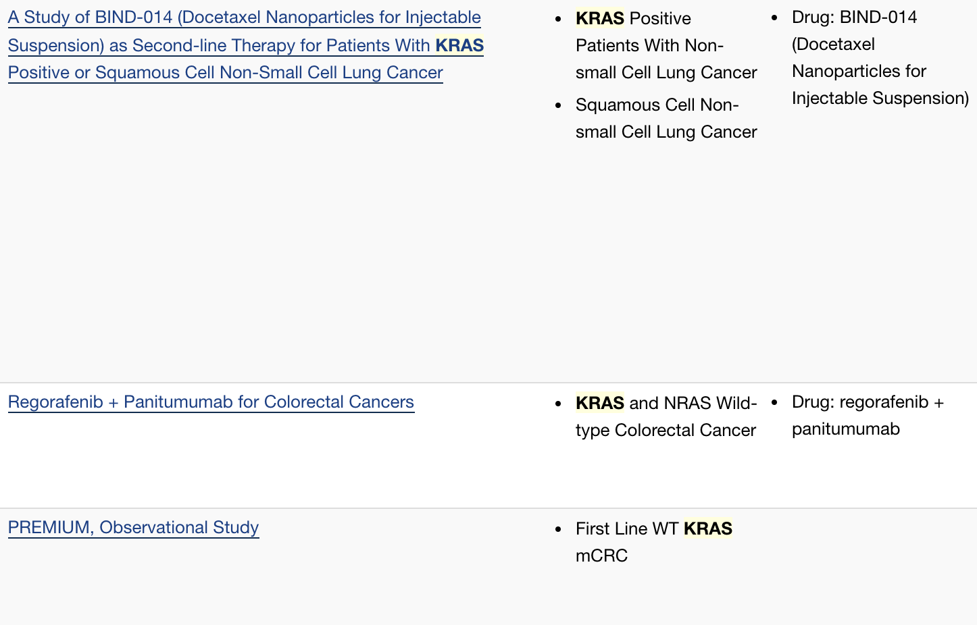
Issues With Human Readable Language

Slide 6
Spiraling Out of Control
35 Tissues, 800 Cancers, 2800 Unique Synonyms
1400 Genes in our clinical panel, sometimes genes and proteins have different names (e.g. ERBB2 vs. HER2)
Also need sentiment analysis to discern whether gene is mentioned in context of mutant or WT
Does it contain a requirements of a specific mutation?

Slide 7
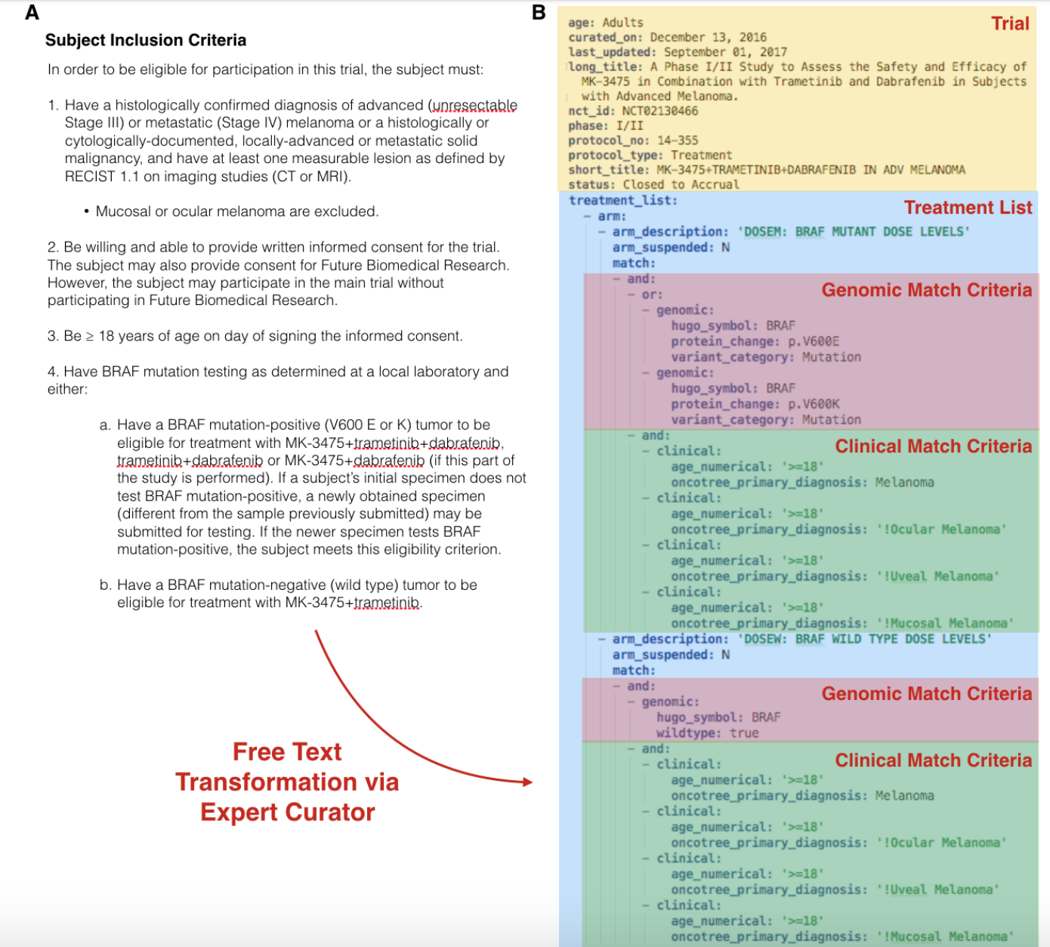
Pivot
Continue to require expert curation
Use our disease and Gene Name synonym lists as valuable reference materials
Attempting regex based matching, able to achieve disease label on 192/206 clinical trials
Build an API so that curated trials can be automatically pulled into our clinical interpretation software

